Slide 1

Effective Nonparametric Distribution Modeling for Distribution Approximation Applications
Thomas C. H. Lux, Layne T. Watson, Tyler H. Chang, Li Xu, Yueyao Wang,
Jon Bernard, Yili Hong, Kirk W. Cameron
Departments of Computer Science, Mathematics,
Aerospace & Ocean Engineering, and Statistics
Virginia Polytechnic Institute and State University

Slide 2
Outline and Hypothesis
Given data, one might want to approximate a true underlying distribution.
There are newly available techniques to make a C2, piecewise quintic monotone approximation to a function.
Hypothesis: Using the nw techniques, we can create a better approximation of a distribution from a sample, improving the estimates produced by distribution prediction models.

Slide 3
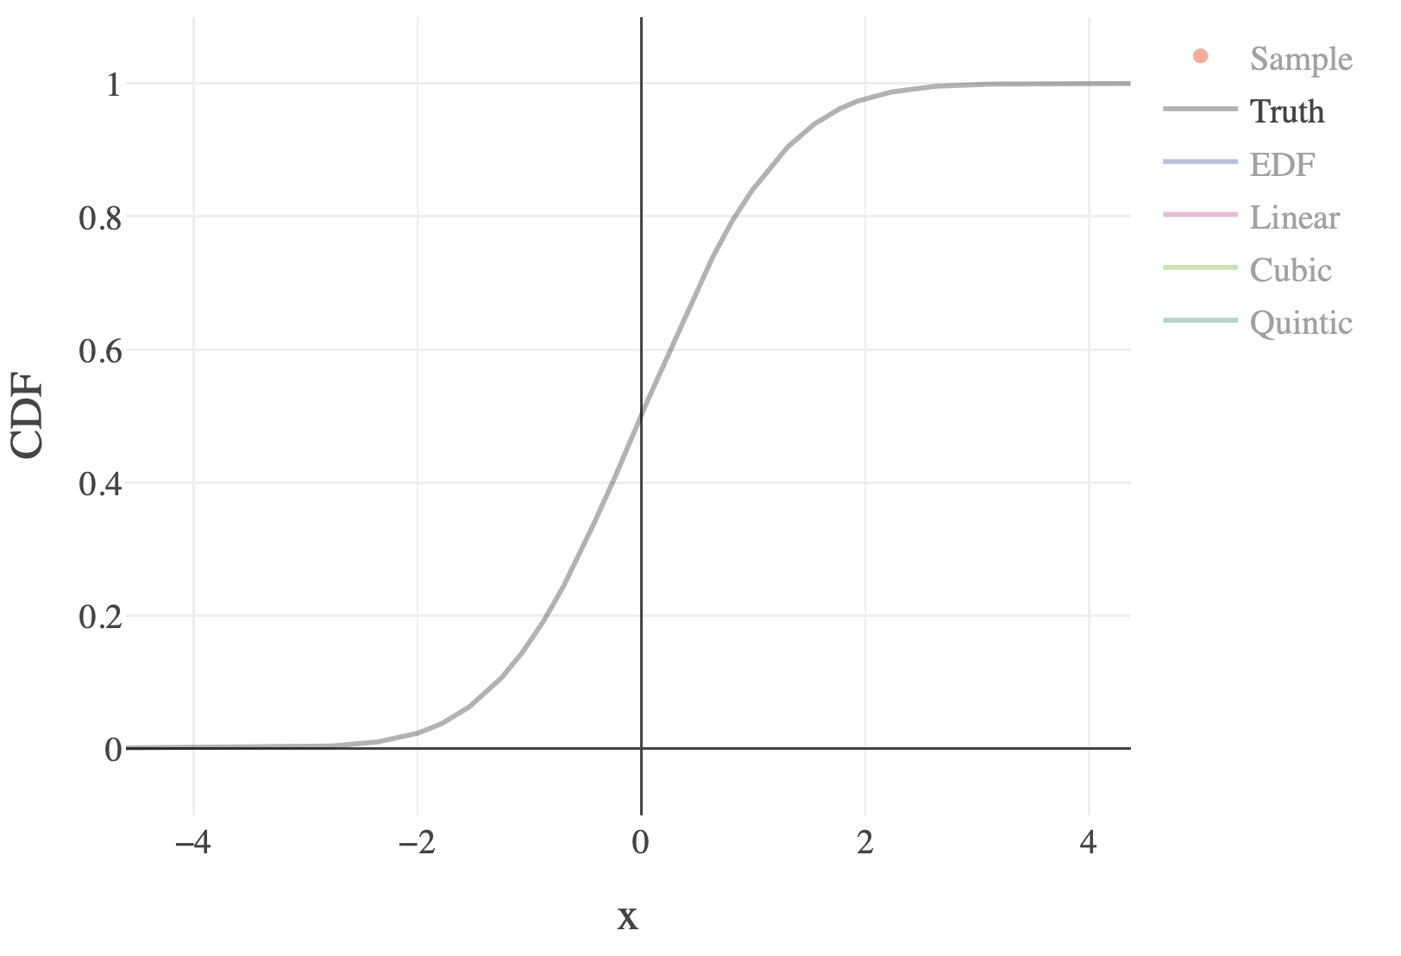
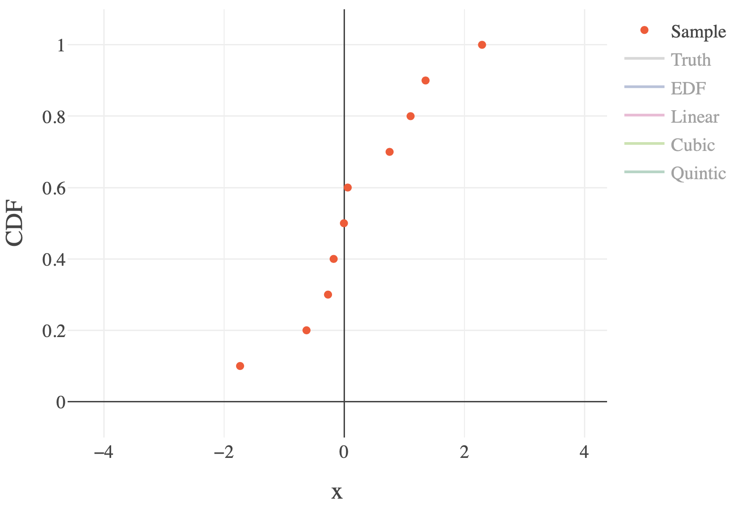
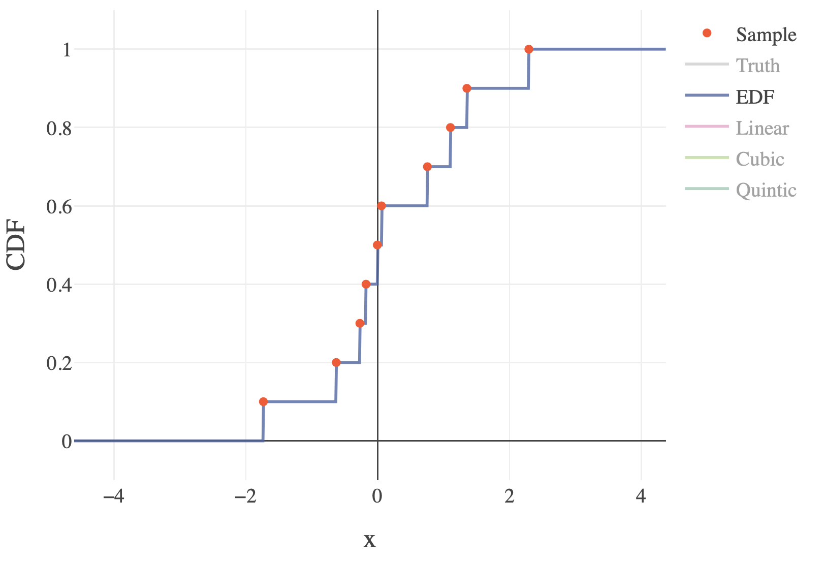
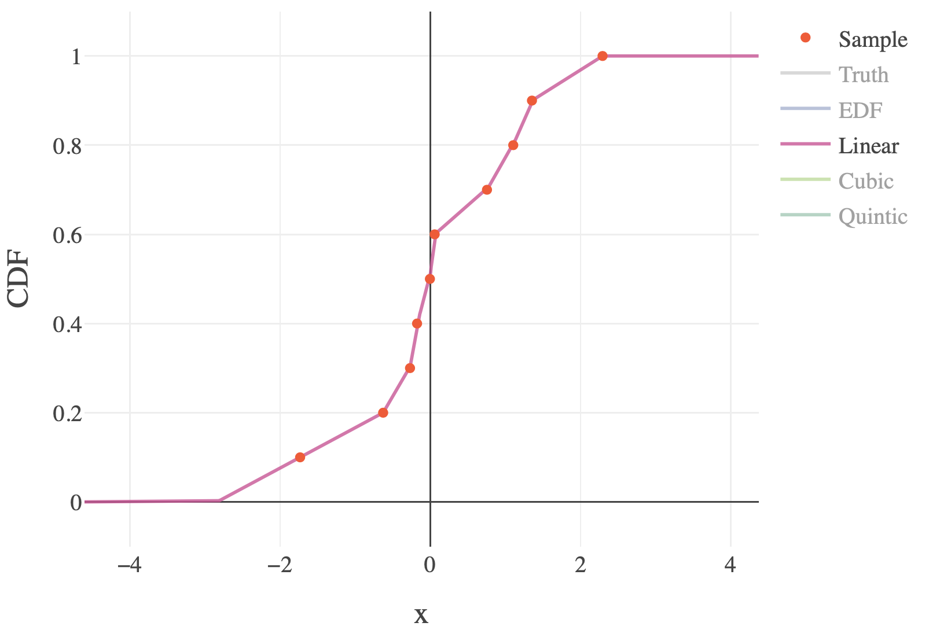
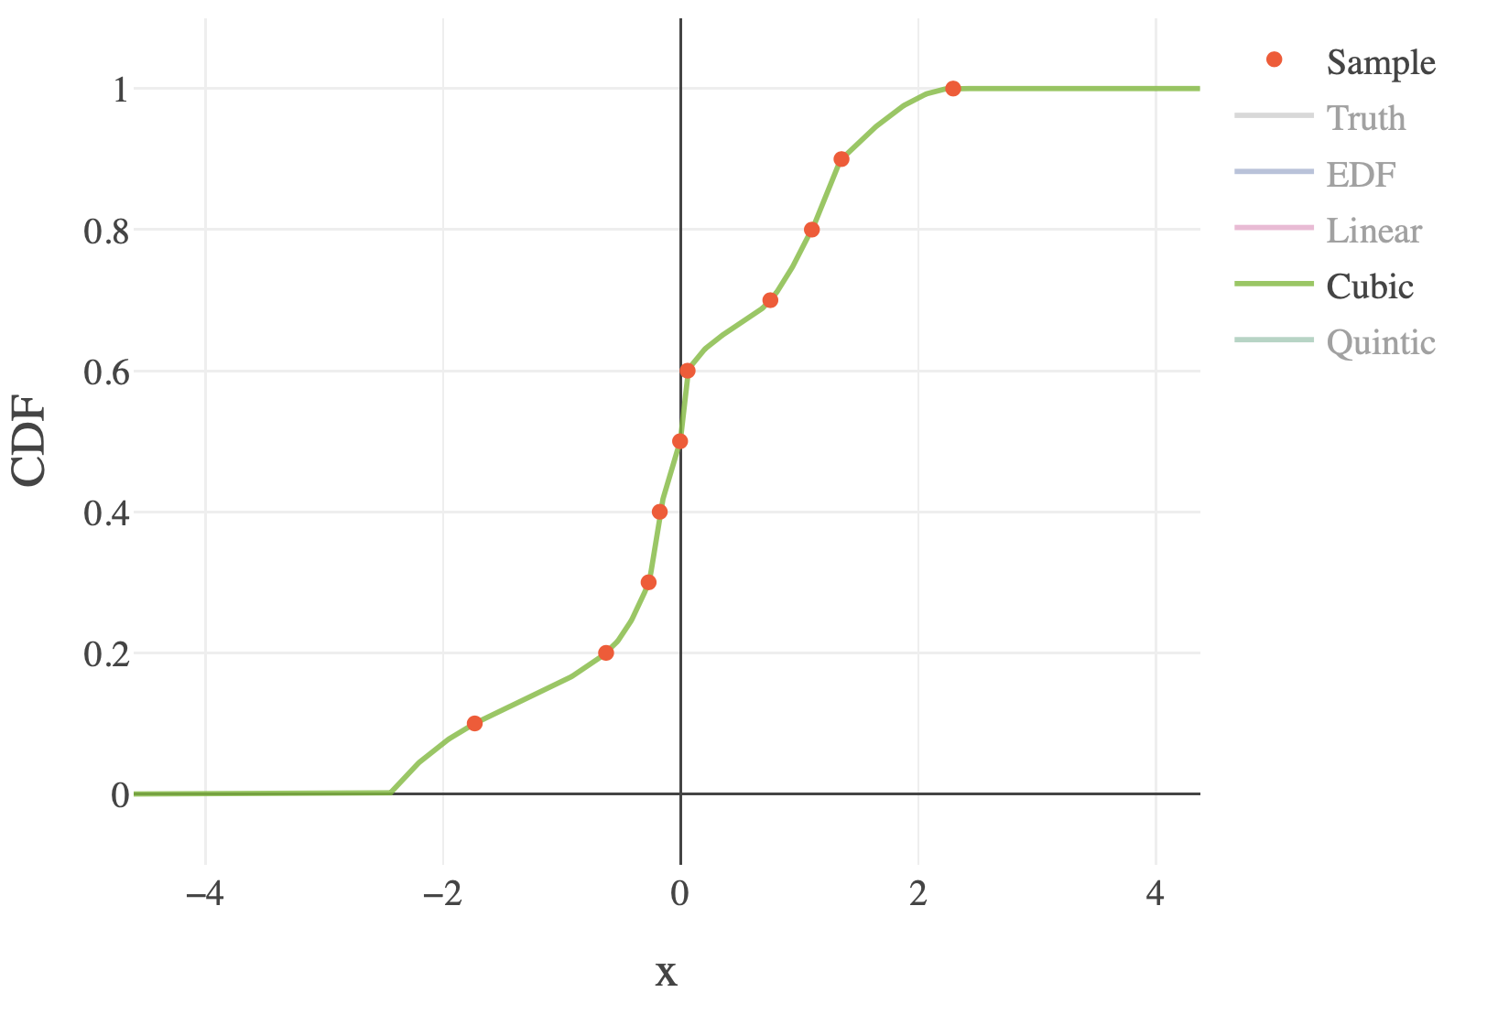
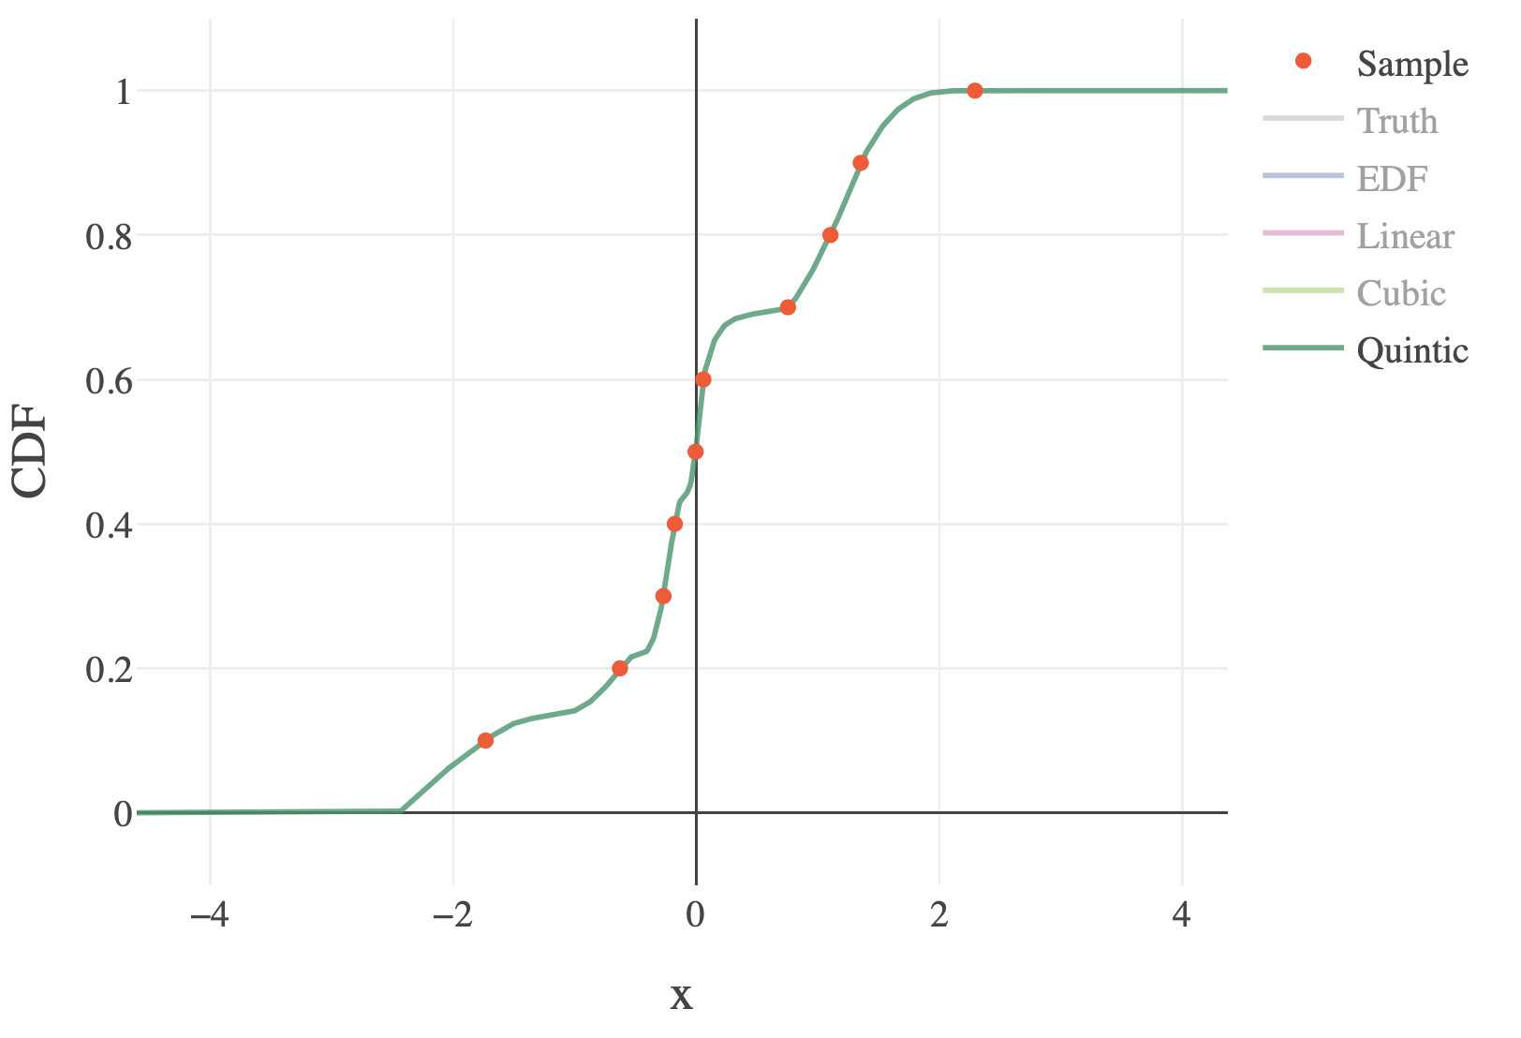
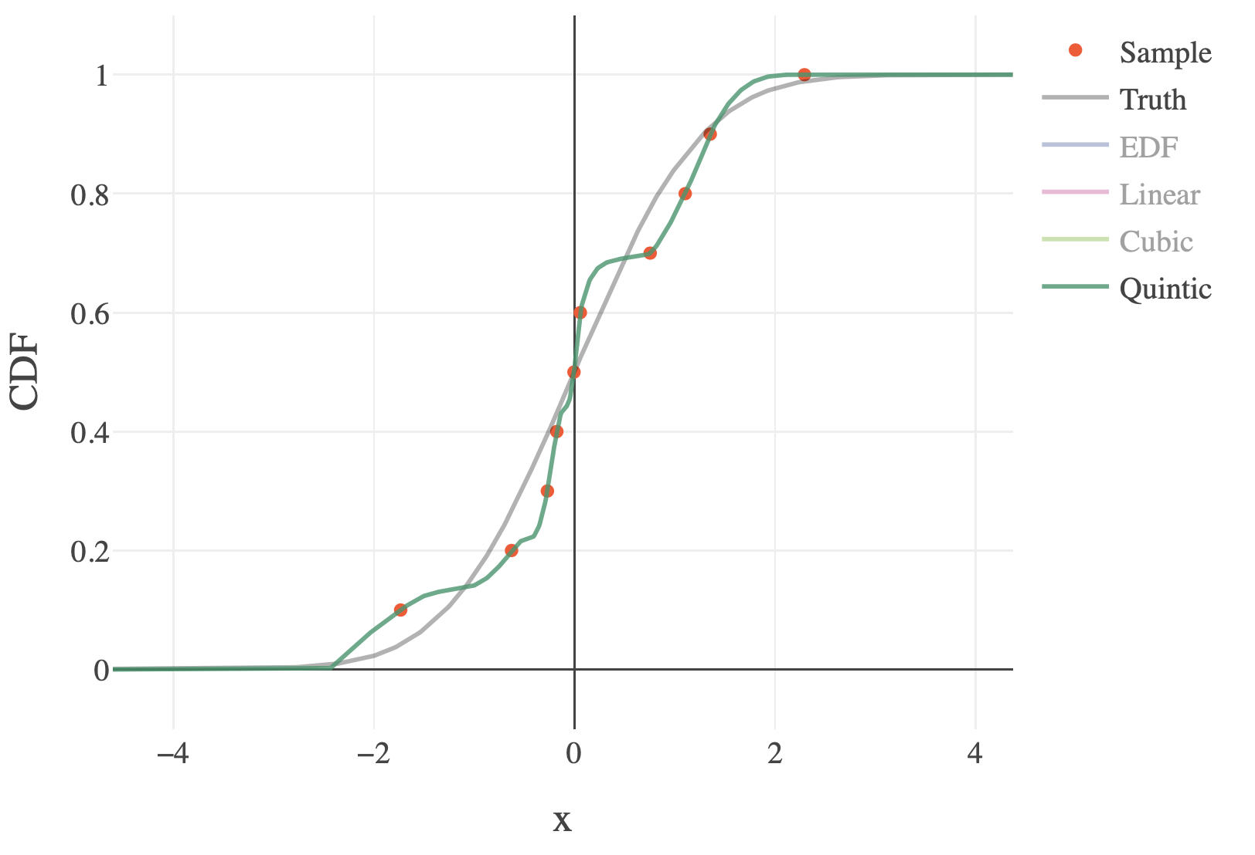
Empirical Distribution Approximations

Slide 4
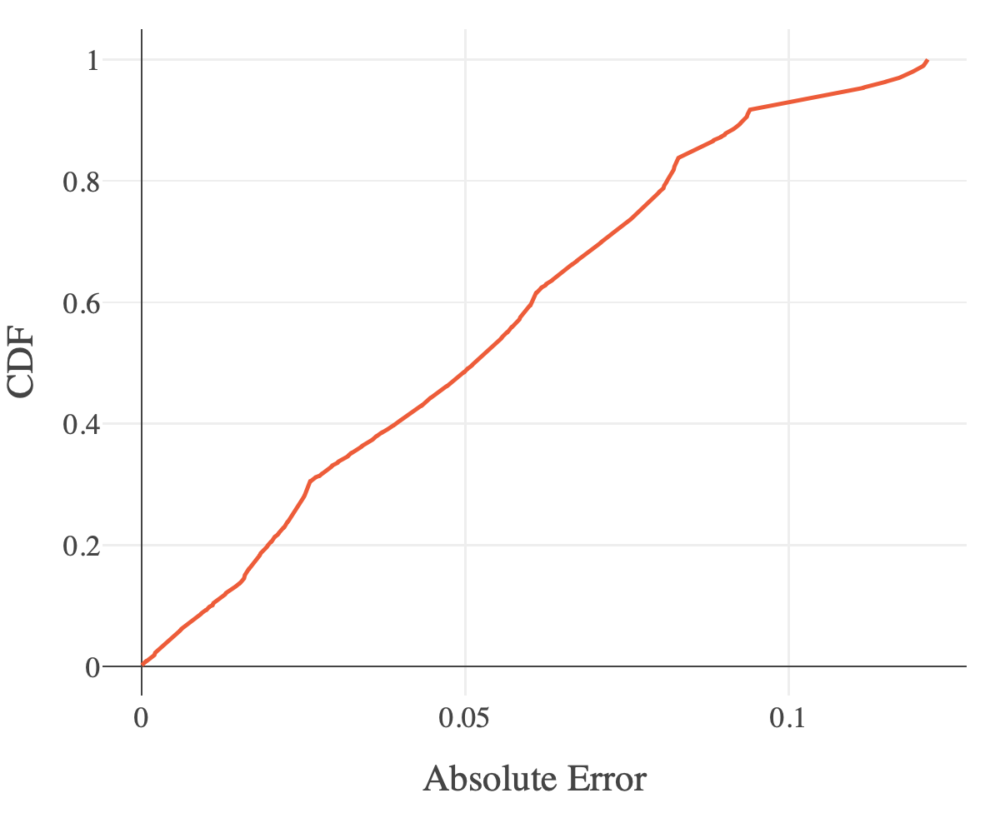
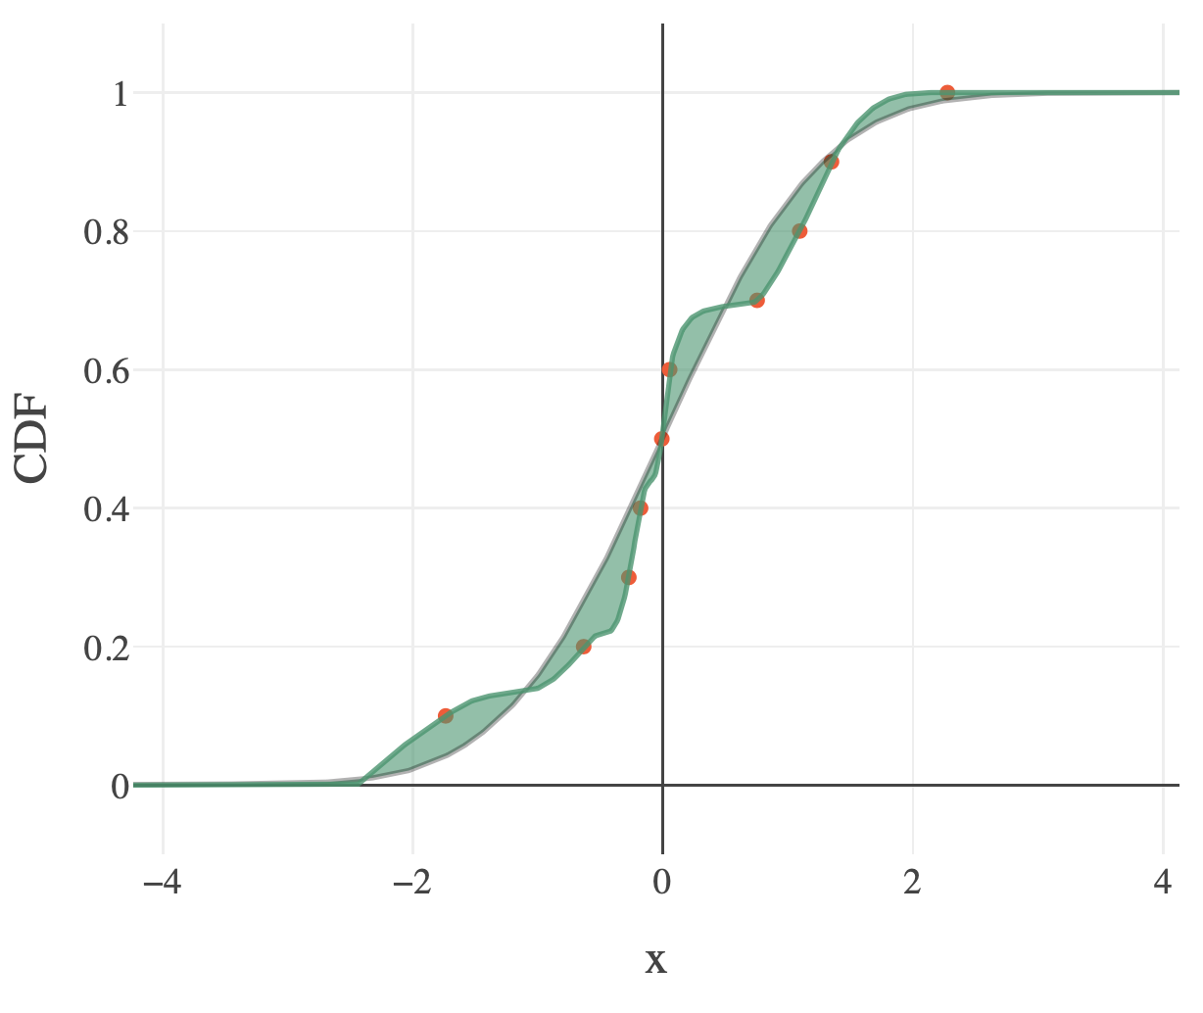
Error of a Distribution Approximation

Slide 5
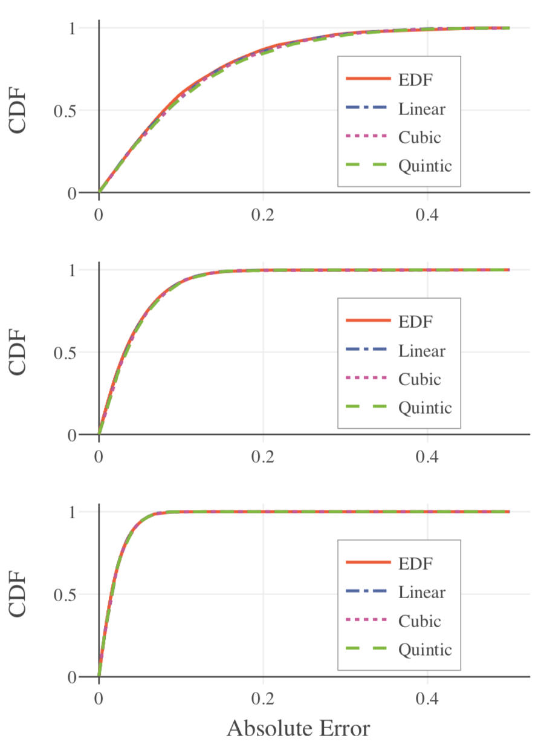
The Errors when Approximating True Distributions with All Techniques
Given 10, 50, and 200 samples respectively, the absolute errors in the approximated distribution look the same for the classic EDF as well as linear, cubic, and quintic interpolants.

Slide 6
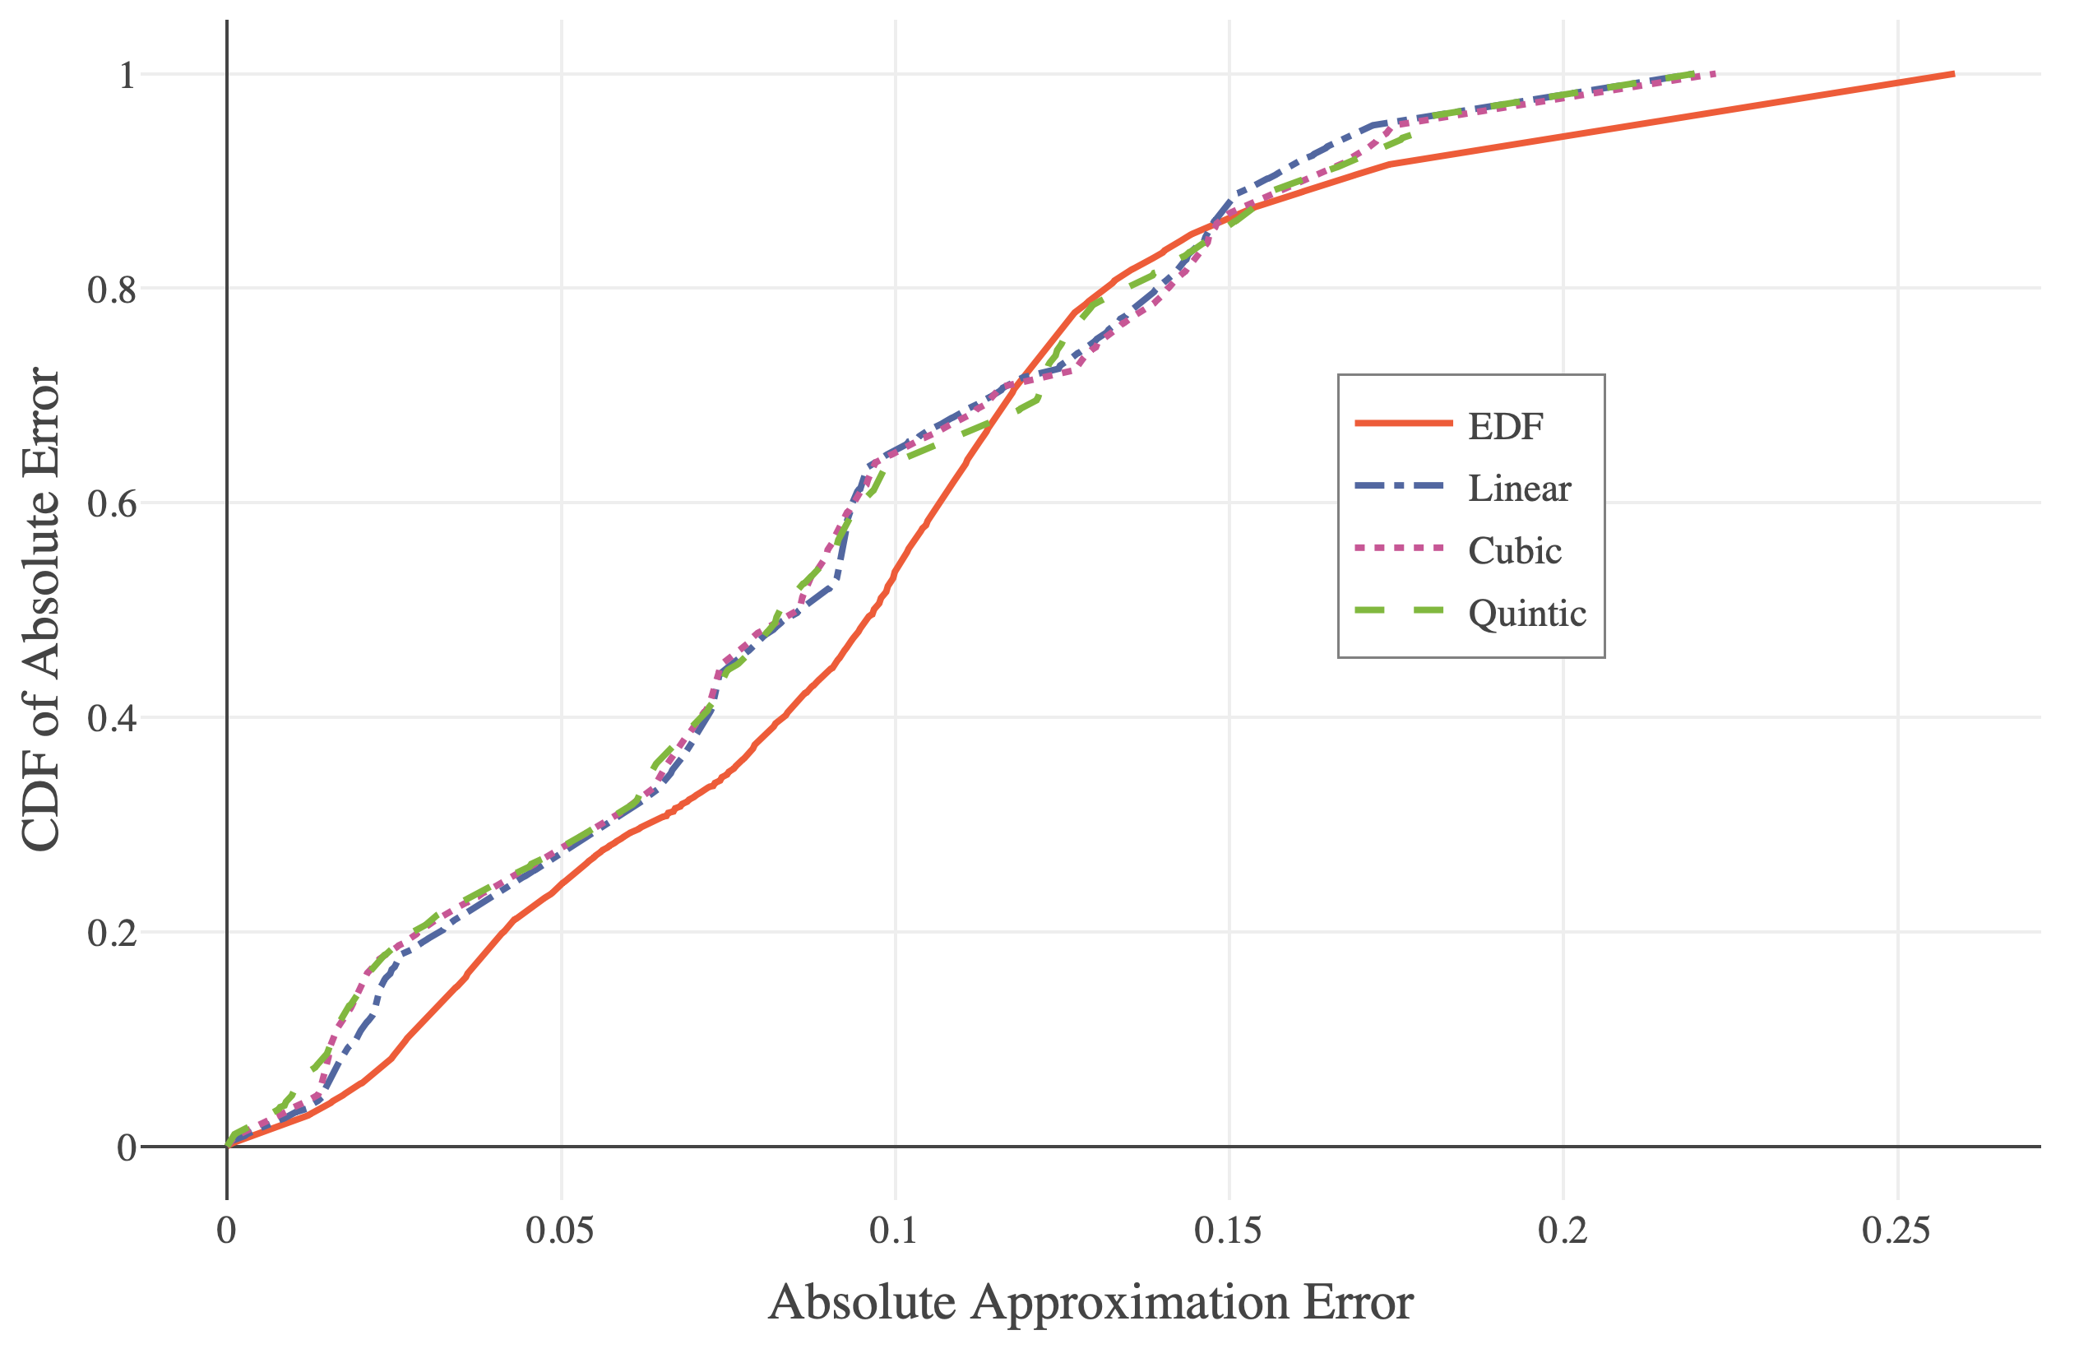
The Quintic is Often Better for
Real-World Data

Slide 7
Conclusions
The quintic method works slightly better than the existing cubic method in distribution approximation applications.
The improvements are not as clear for standard distribution fitting, this is largely a function of how the first and second derivatives are estimated.
Future work should consider alternative methods to estimating the first and second derivatives of a CDF at sample points, to improve estimated distributions.

Slide 8
Acknowledgements
This work was supported as part of the VarSys project by the National Science Grant Foundation grants numbered CNS- 1565314 and CNS-1838271.

